Slide 1
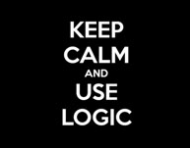

CS 188: Artificial Intelligence
Introduction to Logic
Dr. Malak Abdullah
Computer Science Department
Jordan University of Science and Technology
Notes:
Please retain proper attribution and the reference to ai.berkeley.edu. Thanks!

Slide 2
Outline
Introduction to logic
Basic concepts of knowledge, logic, reasoning
Propositional logic: syntax and semantics
Propositional logic: inference
Agents using propositional logic
First-order logic

Slide 3
Agents that know things
Agents acquire knowledge through perception, learning, language
Knowledge of the effects of actions (“transition model”)
Knowledge of how the world affects sensors (“sensor model”)
Knowledge of the current state of the world
Can keep track of a partially observable world
Can formulate plans to achieve goals
Can design and build gravitational wave detectors…..

Slide 4
Knowledge-Based Agent
A gents that reason by operating on internal representations of knowledge
If it didn't rain, Harry visited Hagrid today.
Harry visited Hagrid or Dumbledore today, but not both.
Harry visited Dumbledore today.
--------------------------------------------------
It rained today.
Harry did not visit Hagrid today.

Slide 5
Knowledge, contd.
Knowledge base (KB) = set of sentences in a formal language
Each sentence is expressed in a language called a knowledge representation language and represents some assertion about the world.
TELL → to add new sentences to the knowledge base
ASK → to query what is known.
Inference → deriving new sentences from old

Slide 6
Knowledge, contd.
Declarative approach to building an agent (or other system):
Tell it what it needs to know (or have it Learn the knowledge)
Then it can Ask itself what to do—answers should follow from the KB
Each time the agent program is called, it does three things.
First, it TELLs the knowledge base what it perceives.
Second, it ASKs the knowledge base what action it should perform. In the process of answering this query, extensive reasoning may be done about the current state of the world, about the outcomes of possible action sequences, and so on.
Third, the agent program TELLs the knowledge base which action was chosen, and the agent executes the action.

Slide 7
Knowledge, contd.
Agents can be viewed at the knowledge level i.e., what they know, regardless of how implemented
A single inference algorithm can answer any answerable question
Knowledge base
Domain-specific facts
Inference engine
Generic code

Slide 8

Logic
Syntax: What sentences are allowed?
The notion of syntax is clear enough in ordinary arithmetic: “x + y = 4” is a well-formed sentence, whereas “x4y+ =” is not.
Semantics:
What are the possible worlds? Which sentences are true in which worlds? (i.e., definition of truth) “x + y =4” is true in a world where x is 2 and y is 2, but false in a world where x is 1 and y is 1.
α₁
α₂
α₃
Syntaxland
Semanticsland

Slide 9
Entailment
The idea that a sentence follows logically from another sentence
Entailment: α |= β (“α entails β” or “β follows from α”) iff in every world where α is true, β is also true
If a sentence α is true in model m, we say that m satisfies α or sometimes m is a model of α. We use the notation M(α) to mean the set of all models of α.
x + y =4
If we are talking about Men and Women in this game, then all possible assignments of real numbers to the variables x and y where total is 4
term “model” → “possible world”

Slide 10
Different kinds of logic
Propositional logic
First-order logic
Relational databases:

Slide 11
PROPOSITIONAL LOGIC
proposition symbol
P Q R True False … etc
The atomic sentences consist of a single proposition symbol
Each such symbol stands for a proposition that can be true or false.

Slide 12
PROPOSITIONAL LOGIC
model
assignment of a truth value to every propositional symbol (a "possible world")
P: It is raining.
Q: It is a Tuesday.
{P = true, Q = false} {P = false, Q = false} ...etc

Slide 13
PROPOSITIONAL LOGIC
Complex sentences are constructed from simpler sentences, using parentheses and logical connectives.
Logical Connectives
¬ not
∧ and
∨ or
→ implication
↔ biconditional

Slide 14
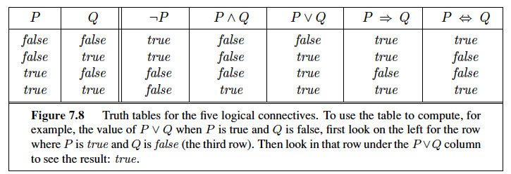
Truth table

Slide 15
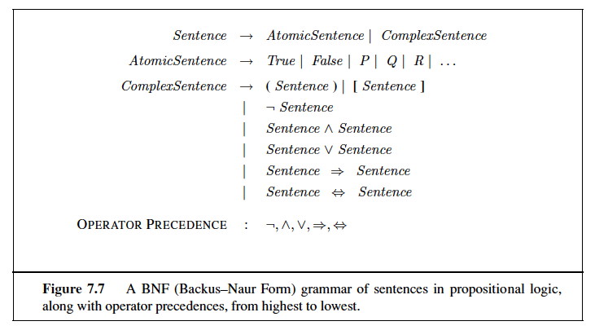
Sentences in PL

Slide 16
PROPOSITIONAL LOGIC
Propositional logic
Syntax: P ∨ (¬Q ∧ R); X₁ ⇔ (Raining ⇒ ¬Sunny)
Possible world (model) : {P=true,Q=true,R=false,S=true} or 1101
Semantics: α ∧ β is true in a world iff is α true and β is true (etc.)
P: It is a Tuesday.
Q: It is raining.
R: Harry will go for a run.
KB: (P ∧ ¬Q) → R P ¬Q
Inference: R

Slide 17
Inference: entailment
Entailment: α |= β (“α entails β” or “β follows from α”) iff in every world where α is true, β is also true
I.e., the α-worlds are a subset of the β-worlds [models(α) ⊆ models(β)]
inference the process of deriving new sentences from old ones

Slide 18
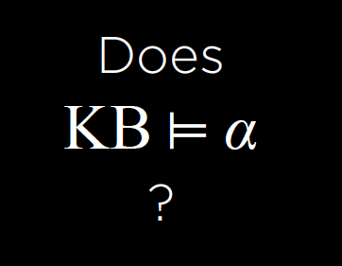
Our goal

Slide 19
Inference: proofs
A proof is a demonstration of entailment between α and β
Sound algorithm: everything it claims to prove is in fact entailed
Complete algorithm: every that is entailed can be proved

Slide 20
Inference: proofs
Method 1: model-checking
For every possible world, if α is true make sure that is β true too
OK for propositional logic (finitely many worlds); not easy for first-order logic
Method 2: theorem-proving
Search for a sequence of proof steps (applications of inference rules) leading from α to β
E.g., from P ∧ (P ⇒ Q), infer Q by Modus Ponens

Slide 21
Model Checking
Model-checking approach: enumerate the models, and check that α is true in every model in which KB is true.
To determine if KB ⊨ α:
• Enumerate all possible models.
• If in every model where KB is true, α is true, then KB entails α.
• Otherwise, KB does not entail α.

Slide 22
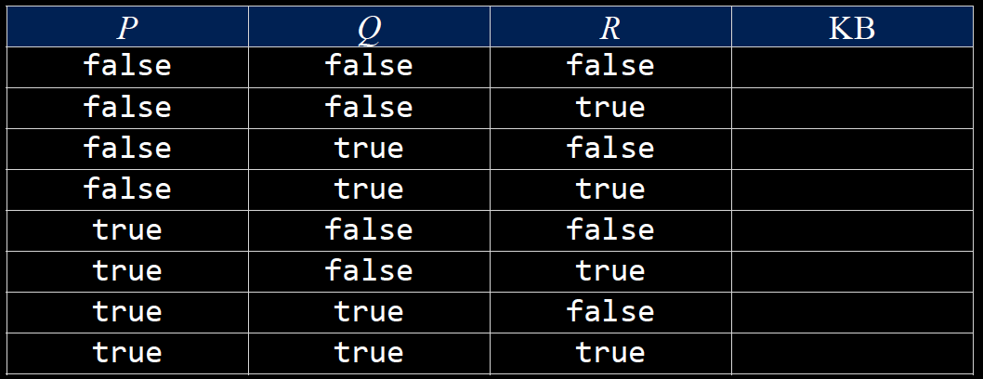
Model Checking
P: It is a Tuesday. Q: It is raining. R: Harry will go for a run.
KB: (P ∧ ¬Q) → R P ¬Q
Query: R

Slide 23
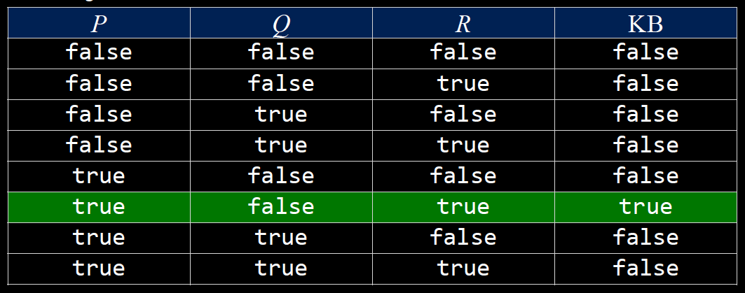
Model Checking
P: It is a Tuesday. Q: It is raining. R: Harry will go for a run.
KB: (P ∧ ¬Q) → R P ¬Q
Query: R
KB Evaluation: The result of the KB evaluation is the conjunction of the results of the evaluations of all the sentences in KB

Slide 24
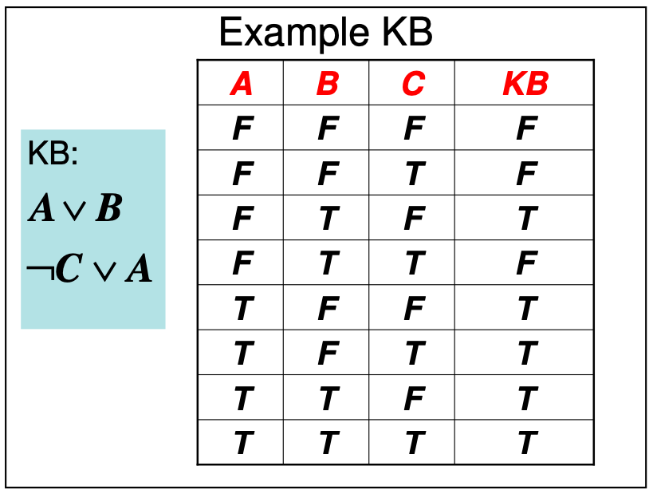
Model Checking
“KB logically entails S” if all the models that evaluate KB to True also evaluate S to True.
Denoted by: KB |= S
Note: We do not care about those models that evaluate KB to False. The result of evaluating S for these models is irrelevant.
S: A∧C is KB |= S ???

Slide 25
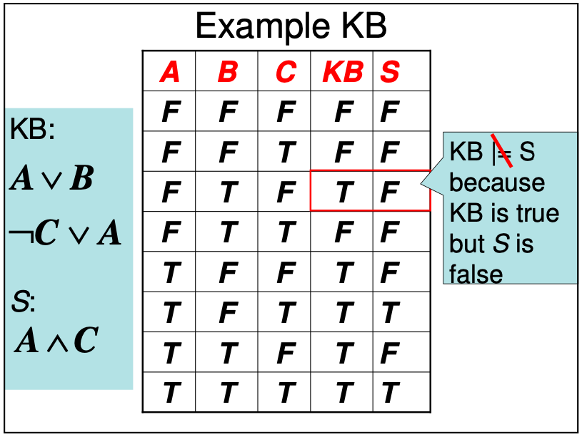

Slide 26
Model Checking
“KB logically entails S” if all the models that evaluate KB to True also evaluate S to True.
Denoted by: KB |= S
Note: We do not care about those models that evaluate KB to False. The result of evaluating S for these models is irrelevant.
S: A∨B∨C
is KB |= S ???

Slide 27
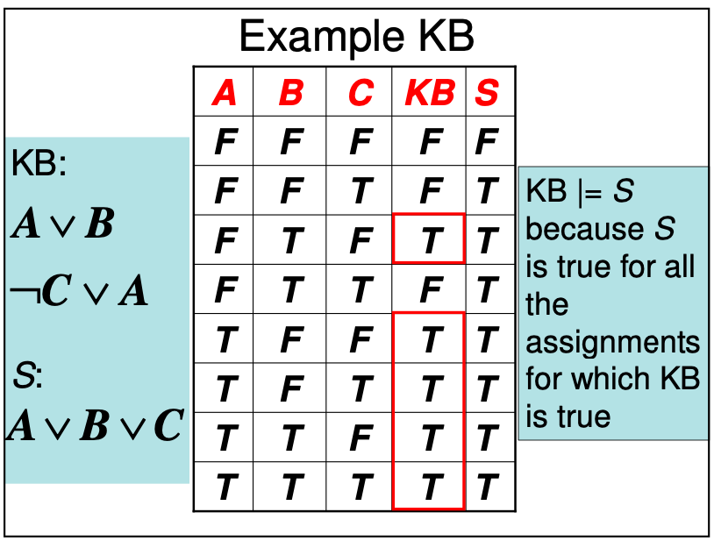

Slide 28
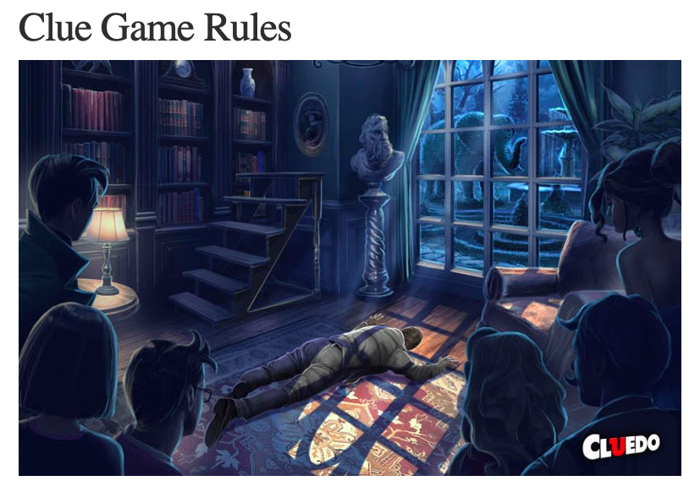

For example
Mr. Boddy is found death in one of the rooms of his mansion.
The players must determine the answers to these three questions: Who killed him? Where? and with What Weapon?

Slide 29
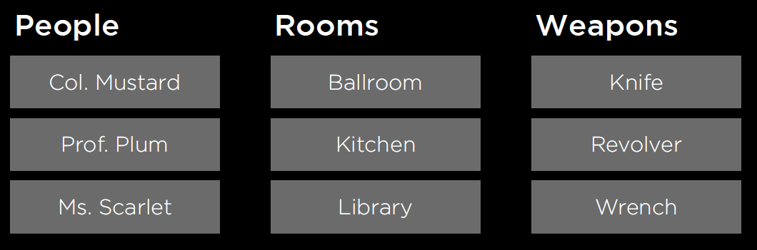
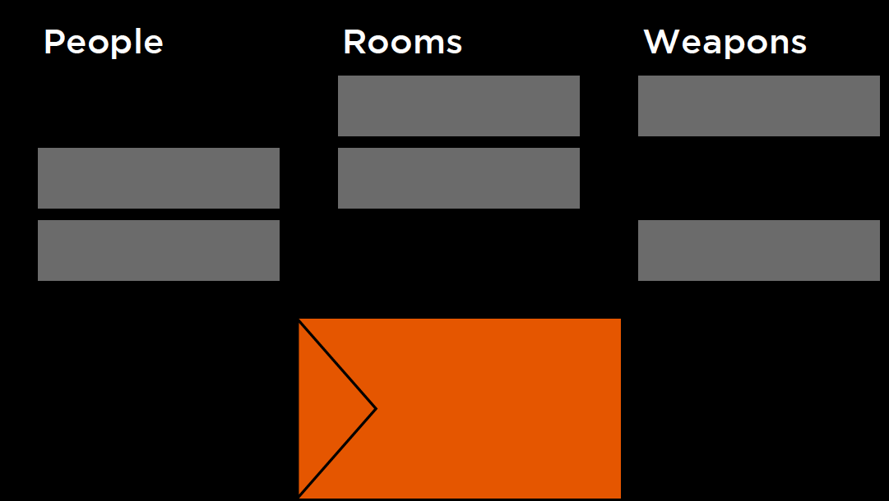
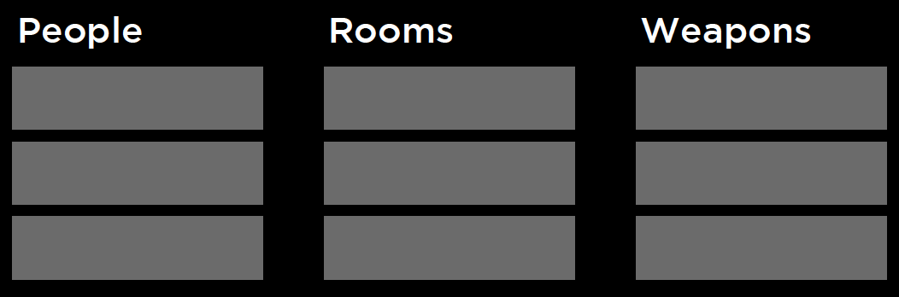
If we have three players
Shuffle the cards and take one card of each kind and put them inside the envelop

Slide 30
Then..
9 Propositional Symbols
Mustard, plum, scarlet
Ballroom, kitchen, library
Knife, revolver, wrench
(mustard ∨ plum ∨ scarlet) one of them is true
(ballroom ∨ kitchen ∨ library) one of them is true
(knife ∨ revolver ∨ wrench) one of them is true
You have plum card then ¬plum is true
Continue..

Slide 31
Another example
Logic Puzzles
• Gilderoy, Minerva, Pomona and Horace each belong to a different one of the four houses: Gryffindor, Hufflepuff, Ravenclaw, and Slytherin House.
• Gilderoy belongs to Gryffindor or Ravenclaw.
• Pomona does not belong in Slytherin.
• Minerva belongs to Gryffindor.

Slide 32
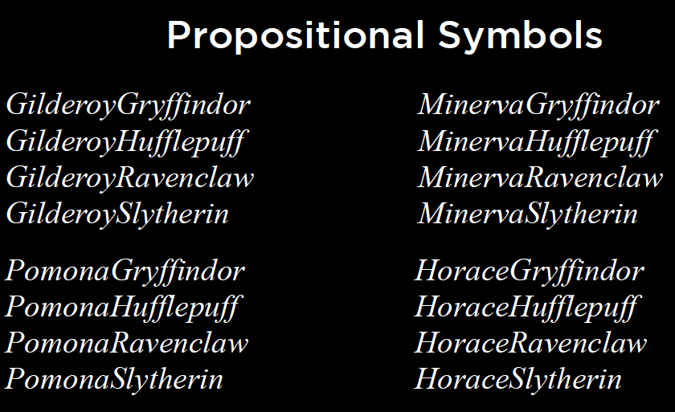
Logic
(GilderoyGryffindor ∨ GilderoyRavenclaw)
(PomonaSlytherin → ¬PomonaHufflepuff)
(MinervaRavenclaw → ¬GilderoyRavenclaw)

Slide 33
Propositional logic syntax
Given: a set of proposition symbols {X₁,X₂,…, X_{n}}
(we often add True and False for convenience)
X_{i} is a sentence
If α is a sentence then ¬α is a sentence
If α and β are sentences then α ∧ β is a sentence
If α and β are sentences then α ∨ β is a sentence
If α and β are sentences then α ⇒ β is a sentence
If α and β are sentences then α ⇔ β is a sentence
And p.s. there are no other sentences!

Slide 34
Propositional logic semantics
Let m be a model assigning true or false to {X₁,X₂,…, X_{n}}
If α is a symbol then its truth value is given in m
¬α is true in m iff α is false in m
α ∧ β is true in m iff α is true in m and β is true in m
α ∨ β is true in m iff α is true in m or β is true in m
α ⇒ β is true in m iff α is false in m or β is true in m
α ⇔ β is true in m iff α ⇒ β is true in m and β ⇒ α is true in m

Slide 35
THEOREM PROVING using Inference Rules
If the number of models is large but the length of the proof is short, then theorem proving can be more efficient than model checking.
logical equivalence: two sentences α and β are logically equivalent if they are true in the same set of models.
We write this as α ≡ β. For example,
we can easily show (using truth tables) that P ∧ Q and Q ∧ P are logically equivalent;

Slide 36
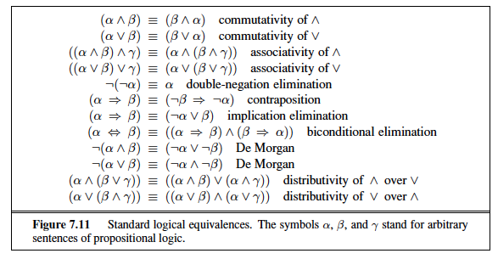
Logical equivalence

Slide 37
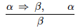
Inference and proofs
derive a proof—a chain of conclusions that leads to the desired goal.
The best-known rule is called Modus Ponens and is written

Slide 38
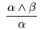
For example
Harry is friends with Ron and Hermione.
------------------------------------------
Harry is friends with Hermione.
And Elimination
If it is raining, then Harry is inside.
It is raining.
-------------------------------
Harry is inside.
Modus Ponens

Slide 39
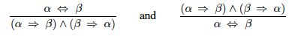
biconditional elimination
It is raining if and only if Harry is inside.
--------------------------------------------------------
If it is raining, then Harry is inside,
and if Harry is inside, then it is raining

Slide 40
It is not true that Harry did not pass the test.
------------------------------------
Harry passed the test.
Double Negation Elimination
¬(¬α)
---------
α

Slide 41
α → β
-----------
¬α ∨ β
Implication Elimination
If it is raining, then Harry is inside.
--------------------------
It is not raining or Harry is inside.

Slide 42
De Morgan's Law
It is not true that both Harry and Ron passed the test.
------------------------
Harry did not pass the test or Ron did not pass the test
¬(α ∧ β)
--------------
¬α ∨ ¬β
It is not true that Harry or Ron passed the test.
--------------------------
Harry did not pass the test and Ron did not pass the test
¬(α ∨ β)
-----------
¬α ∧ ¬β

Slide 43
Distributive Property
(α ∧ (β ∨ γ))
---------------
(α ∧ β) ∨ (α ∧ γ)
(α ∨ (β ∧ γ))
---------------
(α ∨ β) ∧ (α ∨ γ)

Slide 44
Terms
P Q are complementary literals : one is the negation of the other
clause—a disjunction of literals P V Q V R
conjunctive normal form CNF : logical sentence that is a conjunction of clauses
e.g. (A ∨ B ∨ C) ∧ (D ∨ ¬E) ∧ (F ∨ G)

Slide 45
Search Problems
Theorem Proving
initial state: starting knowledge base
actions: inference rules
transition model: new knowledge base after inference
goal test: check statement we're trying to prove
path cost function: number of steps in proof
• initial state
• actions
• transition model
• goal test
• path cost function

Slide 46
Proof by Resolution

Slide 47
It is all about this ☺
(Ron is in the Great Hall) ∨ (Hermione is in the library)
Ron is not in the Great Hall
---------------------------------
Hermione is in the library
P ∨ Q
¬P
-------------
Q
P ∨ Q1 ∨ Q2 ∨ ...∨ Qn
¬P
--------------------
Q1 ∨ Q2 ∨ ...∨ Qn
unit resolution inference rule

Slide 48
(Ron is in the Great Hall) ∨ (Hermione is in the library)
(Ron is not in the Great Hall) ∨ (Harry is sleeping)
------------------------------------------------
(Hermione is in the library) ∨ (Harry is sleeping)
P ∨ Q
¬P ∨ R
----------------------
Q ∨ R
P ∨ Q1 ∨ Q2 ∨ ...∨ Qn
¬P ∨ R1 ∨ R2 ∨ ...∨ Rm
--------------------------------------------
Q1 ∨ Q2 ∨ ...∨ Qn ∨ R1 ∨ R2 ∨ ...∨ Rm

Slide 49
The resolution rule applies only to clauses (that is, disjunctions of literals), so it would seem to be relevant only to knowledge bases and queries consisting of clauses.
How, then, can it lead to a complete inference procedure for all of propositional logic?
The answer is that every sentence of propositional logic is logically equivalent to a conjunction of clauses.
A sentence expressed as a conjunction of clauses is said to be in conjunctive normal form

Slide 50
Conversion to CNF
Eliminate biconditionals
turn (α ↔ β) into (α → β) ∧ (β → α)
Eliminate implications
turn (α → β) into ¬α ∨ β
Move ¬ inwards using De Morgan's Laws
e.g. turn ¬(α ∧ β) into ¬α ∨ ¬β
Use distributive law to distribute ∨ wherever possible

Slide 51
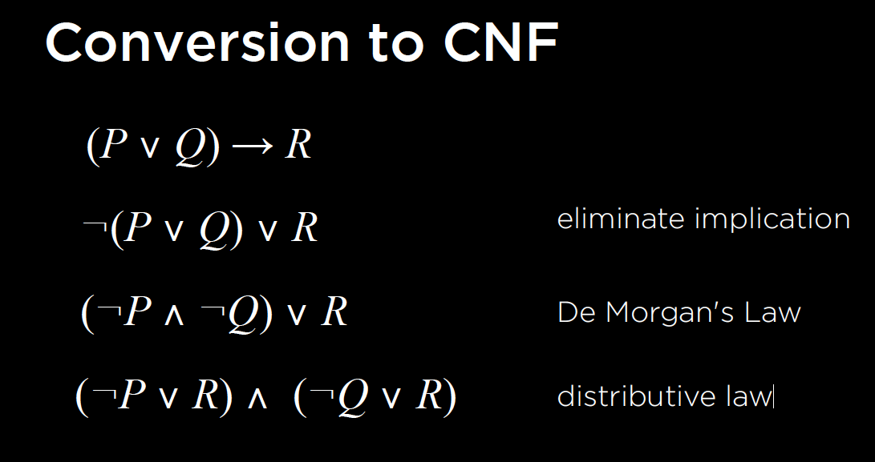
Example

Slide 52
You should know!!!!
P ∨ Q
¬P ∨ R
---------
(Q ∨ R)
P ∨ Q ∨ S
¬P ∨ R ∨ S
----------------
(Q ∨ S ∨ R ∨ S)
P ∨ Q ∨ S
¬P ∨ R ∨ S
---------------
(Q ∨ R ∨ S)
Factoring remove redundant
P
¬P
------
()
Empty clause means false

Slide 53
Inference by Resolution
To determine if KB ⊨ α:
Check if (KB ∧ ¬α) is a contradiction?
If so, then KB ⊨ α.
Otherwise, no entailment.
Proof the opposite of what we want ☺

Slide 54
Inference by Resolution
To determine if KB ⊨ α:
Convert (KB ∧ ¬α) to Conjunctive Normal Form.
Keep checking to see if we can use resolution to produce a new clause.
If ever we produce the empty clause (equivalent to False), we have a contradiction, and KB ⊨ α.
Otherwise, if we can't add new clauses, no entailment.

Slide 55
Example
Does (A ∨ B) ∧ (¬B ∨ C) ∧ (¬C) entail A?
(A ∨ B) ∧ (¬B ∨ C) ∧ (¬C) ∧ (¬A)
(A ∨ B) (¬B ∨ C) (¬C) (¬A)
¬B

Slide 56
Example
Does (A ∨ B) ∧ (¬B ∨ C) ∧ (¬C) entail A?
(A ∨ B) ∧ (¬B ∨ C) ∧ (¬C) ∧ (¬A)
(A ∨ B) (¬B ∨ C) (¬C) (¬A)
¬B
A

Slide 57
Example
Does (A ∨ B) ∧ (¬B ∨ C) ∧ (¬C) entail A?
(A ∨ B) ∧ (¬B ∨ C) ∧ (¬C) ∧ (¬A)
(A ∨ B) (¬B ∨ C) (¬C) (¬A)
( )
¬B
A
False ----> means we have contradiction→ means KB ⊨ α

Slide 58
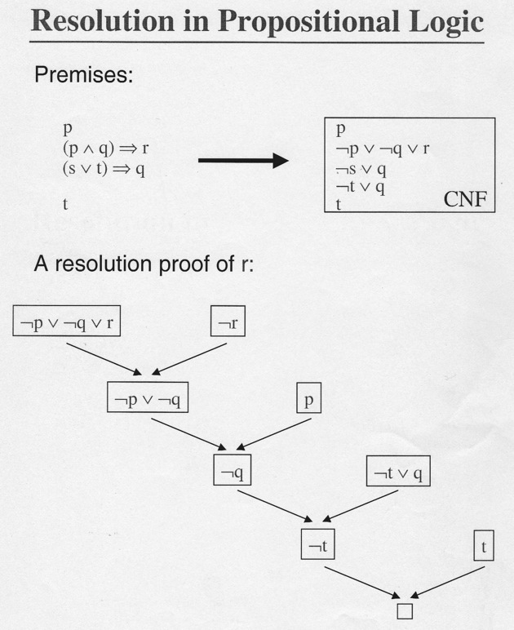
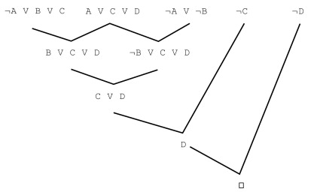
Proof r Proof D

Slide 59
Different kinds of logic
Propositional logic
First-order logic
Relational databases:

Slide 60
First-order logic FOL
Propositional Logic
Propositional Symbols
MinervaGryffindor
MinervaHufflepuff
MinervaRavenclaw
MinervaSlytherin …
First-Order Logic
Constant Symbol Predicate Symbol Minerva house
Pomona person
Horace BelongsTo
Gilderoy
Gryffindor
Hufflepuff
Ravenclaw
Slytherin

Slide 61
First-Order Logic
Person(Minerva) Minerva is a person.
House(Gryffindor) Gryffindor is a house.
¬House(Minerva) Minerva is not a house.
BelongsTo(Minerva, Gryffindor) Minerva belongs to Gryffindor.

Slide 62
Universal Quantification ( ∀ )
∀x. BelongsTo(x, Gryffindor) → ¬BelongsTo(x, Hufflepuff)
For all objects x, if x belongs to Gryffindor, then x does not belong to Hufflepuff.
Anyone in Gryffindor is not in Hufflepuff.

Slide 63
Existential Quantification (∃ )
∃x. House(x) ∧ BelongsTo(Minerva, x)
There exists an object x such that x is a house and Minerva belongs to x.
Minerva belongs to a house.
∀x. Person(x) → (∃y. House(y) ∧ BelongsTo(x, y))
For all objects x, if x is a person, then there exists an object y such that y is a house and x belongs to y.
Every person belongs to a house.

Slide 64
Fun with sentences
Everyone knows President Obama
∀n Person(n) ⇒ Knows(n,Obama)
There is someone that everyone knows
∃s Person(s) ∧ ∀n Person(n) ⇒ Knows(n,s)
Everyone knows someone
∀x Person(x) ⇒ ∃y Person(y) ∧ Knows(x,y)

Slide 65
More fun with sentences
Any two people of the same nationality speak a common language
Nationality(x,n) – x has nationality n
Speaks(x,l) – x speaks language l
∀x,y (∃ n Nationality(x,n) ∧ Nationality(y,n)) ⇒
(∃ l Speaks(x,l) ∧ Speaks(y,l))

Slide 66
Think about these examples for FOL
Every dog chases some rabbit.
Anyone who owns a rabbit hates anything that chases any rabbit.
John owns a dog.
Someone who hates something owned by another person will not marry that person.

Slide 67
Every dog chases some rabbit.
∀ x (DOG(x) → ∃ y (RABBIT(y) ∧ CHASE(x,y)))

Slide 68
Anyone who owns a rabbit hates anything that chases any rabbit.
∀ x ∀ y (OWNS(x,y) ∧ RABBIT(y) → ∀ z ∀ w (RABBIT(w) ∧ CHASE(z,w) → HATES(x,z)))

Slide 69
John owns a dog.
∃ x (DOG(x) ∧ OWNS(John,x))

Slide 70
Someone who hates something owned by another person will not marry that person.
∀ x ∀ y ∀ z (OWNS(y,z) ∧ HATES(x,z) → ¬ Marry(x,y))

Slide 71
Any student who does not study does not pass.
∀ x (STUDENT(x) ∧ ¬ STUDY(x) → ¬ PASS(x))

Slide 72
Examples
Every coyote chases some roadrunner. ∀ x (COYOTE(x) → ∃ y (RR(y) ∧ CHASE(x,y)))
Every roadrunner who says ``beep-beep'' is smart. ∀ x (RR(x) ∧ BEEP(x) → SMART(x))
No coyote catches any smart roadrunner. ¬ ∃ x ∃ y (COYOTE(x) ∧ RR(y) ∧ SMART(y) ∧ CATCH(x,y))
Any coyote who chases some roadrunner but does not catch it is frustrated. ∀ x (COYOTE(x) ∧ ∃ y (RR(y) ∧ CHASE(x,y) ∧ ¬ CATCH(x,y)) → FRUSTRATED(x))
(Conclusion) If all roadrunners say ``beep-beep'', then all coyotes are frustrated. (∀ x (RR(x) → BEEP(x)) → (∀ y (COYOTE(y) → FRUSTRATED(y)))

Slide 73
Inference in FOL
Entailment is defined exactly as for propositional logic:
α |= β (“α entails β”) iff in every world where α is true, β is also true
E.g., ∀x Knows(x,Obama) entails ∃y∀x Knows(x,y)
In FOL, we can go beyond just answering “yes” or “no”; given an existentially quantified query, return a substitution (or binding) for the variable(s) such that the resulting sentence is entailed:
KB = ∀x Knows(x,Obama)
Query = ∃y∀x Knows(x,y)
Answer = Yes, σ = {y/Obama}
Notation: ασ means applying substitution σ to sentence α
E.g., if α= ∀x Knows(x,y) and σ = {y/Obama}, then ασ = ∀x Knows(x,Obama)

